Slide 1
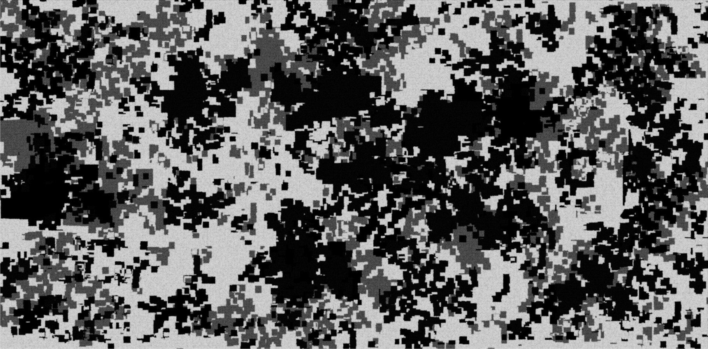
INFORMATION
WARFARE

Slide 2
What is Information Warfare?
“All actions taken to defend the military’s information-based processes, information systems and communications networks and to destroy, neutralise or exploit the enemy’s similar capabilities within the physical, information and cognitive domains.” Maj. Gen. Brazzoli
“All actions taken to defend the military’s information-based processes, information systems and communications networks and to destroy, neutralise or exploit the enemy’s similar capabilities within the physical, information and cognitive domains.” Maj. Gen. Brazzoli – SANDF Vision 2020
“Offensive and defensive operations against information resources of a "win-lose" nature. It is conducted because information resources have value to people. Offensive operations aim to increase this value for the offence while decreasing it for the defence. Defensive operations seek to counter potential losses in value.” Dorothy Denning – Information Warfare & Security

Slide 3
What is Information Warfare?
Winn Schwartau:
Class I: Personal IW
Class II: Corporate IW
Class III: Global IW
Cronin & Crawford:
Personal IW
Corporate / economic IW
Community / social IW
10001010011001000100010■011100110000101000100010001000111□001000110010010100001000100100100010001■0001000100100010010010010010000011100■1100000100110010001001001000100□100010010010010010001000100100100100100110001100100101001010010101010011□0000111010011111000010010001000011010011110□101101□010000100100101111010101010101010101010010101010010111000001010100100100010100100011100100001110010001100010001■00010001001010000010

Slide 4
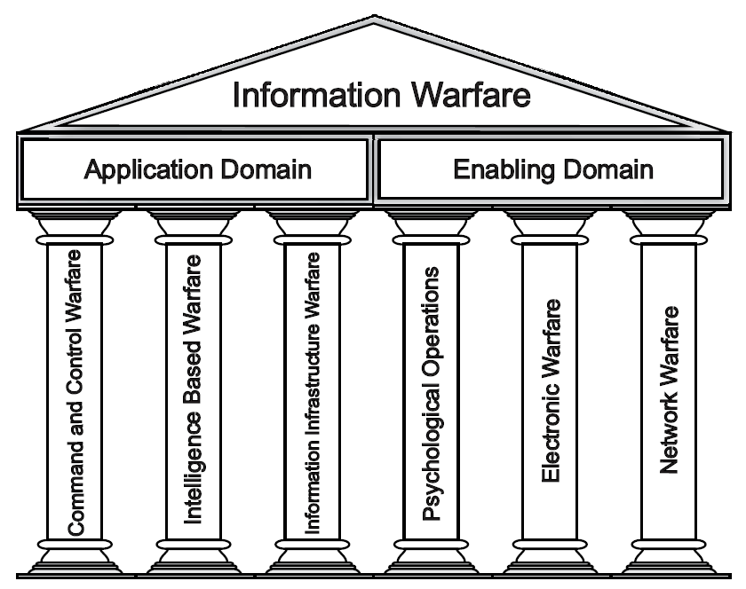
Information Warfare Functional areas

Slide 5
Information operations construct
INFORMATION OPERATIONS
Information in War, Peace & Business
Information Warfare
Gain
Exploit
Attack
Defend
Intelligence, Surveillance & Reconnaissance
(ISR)
Precision Navigating & Positioning
Other Information Collection and
Dissemination Activities
PSYOPs
EW
Military Deception
Physical Attack
Information Attack
Information
Assurance
OPSEC
TRANSEC
Counter
Intelligence
Counter PSYOP
Electronic Protection
Counter Deception
Adapted from US Air Force

Slide 6
Stages of Information warfare
 |  |  |  |  |  |  |  |  |  |  |  |  |  | Stage 6: Reconstruction
 |  |  |  |  |  |  |  |  |  |  |  | Stage 5: Combat |  | (Precision and Info Weapons, EW)
 |  |  |  |  |  |  |  |  | Stage 4: Military Posturing |  |  |  |  | (Deception)
 |  |  |  |  |  |  | Stage 3: Economic Pressure |  |  |  |  |  | (Economic Information Warfare)
 |  |  |  |  | Stage 2: Diplomatic Pressure |  |  |  |  |  |  | (PSYOPS, Perception Management)
 |  |  | Stage 1: Intelligence Gathering |  |  |  |  |  |  |  | (Protection, Exploitation, Hacker War)
Pre-Hostilities
Post-Hostilities
Adapted from (Jones, Kovacich & Luzwick, 2002)

Slide 7
Information Warfare threats
Information Warfare Threats – US Air Force
Compromise | Deception/ Corruption | Denial/ Loss | Destruction
Malicious Code System Intrusion Psychological Ops Intel Collection Technology Transfer Software Bugs | Malicious Code System Intrusion Military Deception Spoofing Imitation | Malicious Code System Intrusion Lasers Physical Attack EMP Virus Insertion System Overload Radio Frequency Jamming | Malicious Code Bombs Directed Energy Weapons Lasers Physical Attack EMP Biological & Chemical Warfare

Slide 8
Ew vs nw
Electronic Warfare
Electronic Attack
Electronic Protection
Electronic Support
Anti-radiation
Directed energy
Jamming
Deception
EMCON
Hardening
Spectrum management
LPI
Anti-jam
Threat warning
Direction finding
Intelligence collection

Slide 9
Ew vs nw
Network Warfare
Computer Network Attack
Computer Network Defence
Computer Network Support
DDoS
Malware
Hacking
Espionage
Firewalls
Anti-virus
Intrusion detection
Honey pots/nets
IDS
Vulnerability testing
Monitoring

Slide 10
Ew vs nw
 | EW | NW
Disrupt / Deny / Destroy | Radio Frequency Jamming Anti-Radiation Missile Low Observability Technology | Denial of Service Attack Physical Destruction Delete Information Firewalls
Exploit | Signals Intelligence Communications Intelligence Electronic Intelligence Identification Friend of Foe | Sniffers Scanners Backdoors Intrusion Detection Systems
Corrupt | Chaff Flares Low Observability Technology | Honey pots Honey nets Root-kits Malware

Slide 11
Network warfare Attack
1. Identify Target
2. Identify GII & NII Interfaces
3. Research Nation’s Systems & Networks
4. Gather Intelligence Information
5. Identify Vulnerabilities
6. Covertly Probe & Test for Traps & Responses
7. Enter System, Locate & Transmit Sensitive Information to Safe Location
8. Probe for Other Systems and Networks
10. Set Logic Bombs, Trap Doors, Delete Intrusion Evidence; Leave System
11. Search for Additional Target Systems and Networks; Repeat Steps 1-10
12. Attack Systems and Networks During Conflict
9. Probe Systems and Networks for Additional Information
Network Warfare Attack Process
Adapted from (Jones, Kovacich & Luzwick, 2002)

Slide 12
Network warfare defence
Defence-in-Depth adds layers of defence & recovery at each stage
Intrusions past first line of defence
Attack mounted
Recovery
Penetration
detected
Defensive response
Offensive response
Threats
Vulnerability | Impact | Recovery & response
Keep more attacks out: Earlier and more accurate attack predictors Fewer access points Fewer weaknesses | Reduce mission impact & damage: -Make defensive response earlier -Work-arounds -Resilient ConOps | Continue operations -Real time information recovery and system reconfiguration -Deceive BDA
Adapted from (Jones, Kovacich & Luzwick, 2002)

Slide 13
Critical infrastructure protection
Information security protects corporate information and systems.
What happens if the computers control infrastructure?
Australian sewerage incident
VIDEO: http://www.youtube.com/watch?v=rTkXgqK1l9A&NR=1

Slide 14
Incidents
Solar Sunrise (1998)
Moonlight Maze (1999) Russia?
Titan Rain (2003-2004) China?
Vodafone Greece (2004-2005)
Estonia (2007) Russia?
Georgia (2008) Russia?
Korea (2009)
Twitter (2009)
GhostNet (2007-2009) China?
GhostNet 2.0 (2009-2010) China?
Aurora/Google (2009-2010) China?

Slide 15
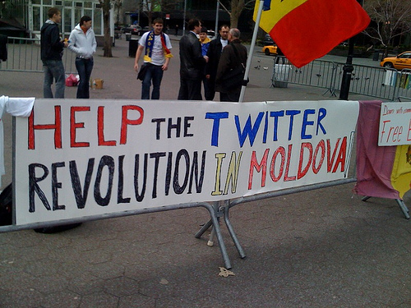
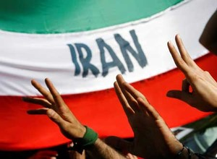
Media & web info wars
NATO vs Serbia
Afghanistan
Gulf War 2
Wikileaks
Israel / Palestine
India / Pakistan
Other
Moldova
Urumqi (China)
Iran

Slide 16
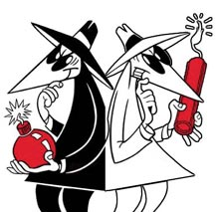
Role of Whitehats / ethical hackers
Computer Network Support:
Penetration / vulnerability testing
“Intelligence” & awareness support
Information security / assurance

Slide 17
Future Information Warfare
Mobile IW?
Smartphones are mini-computers without the security
Combining threats & vulnerabilities of internet, wireless & cell phones
4.1 billion mobile endpoints expected by 2014 (www.mobileactivedefense.com)
Quantum computing?

